Slide 1

Effect of Inflation on Economic Growth Dynamics in India

Slide 2

Members:-
Abhijeet Chavan 19084
Hruturaj Dhake 19104
Vedisha Wasnik 19336
Anushka Shelke 19290
Ishita Khartad 19165

Slide 3

What is the Research About:-
The study investigates the impact of inflation rate on economic growth to find the best-fit model for economic growth in India.
Using the ARIMA, VAR and GARCH, it forecast the GDP and compare the output from the three models.
The data is collected in period from 1960 to 2021, to test stationarity, cointegration between GDP and CPI, and Granger causality.

Slide 4

Why Do we Need to Measure the Effect of Inflation on Economic Growth in India:-
Inflation created problem and introduced noises in the functioning of the economy that is likely to affect economic growth
If it maintained between allowable levels then it is good for Economic Growth; but if it is below or above the allowable level then it can cause damage to the economy.
Forecasting inflation is important for individuals so they can accurately budget their income and account for future price increases.
Inflation is seen as a continuous and rapid rise in the price level.

Slide 5
Unit root test
Augmented Dickey-Fuller Test to check stationarity.
Phillips–Perron (PP) tests
Kwiatkowski–Phillips–Schmidt–Shin (KPSS) Test
GDP was not stationary, we did second difference to make stationary then checked again by adf- test.

Slide 6

Methodology
First we forecast the GDP and CPI using the ARIMA Model.
To check the Unit Root and Stationarity we make use of the ADF and KPSS Test.
The results are:- 2nd Difference of GDP is Stationary &
CPI is Stationary
Then we plot the Acf and Pacf graphs, to study behavior of variable.

Slide 7
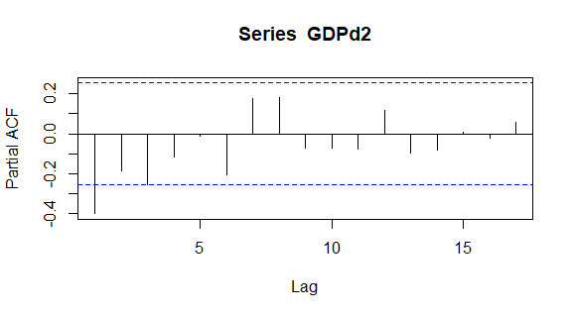
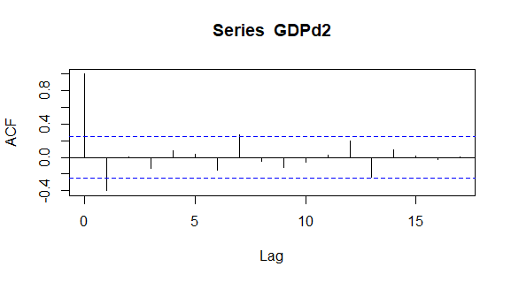
Methodology
Then we plot the Acf and Pacf graphs of 2nd Difference GDP:-
The Pacf (p) value of 2nd Difference GDP is significant at :- 1 & 3
The Acf (q) value 2nd Difference GDP is significant at :- 1 &7
Then we use the different combinations of p and q try to forecast the GDP.
After Training and Testing ARIMA(3,2,1) was the best fit for GDP.

Slide 8
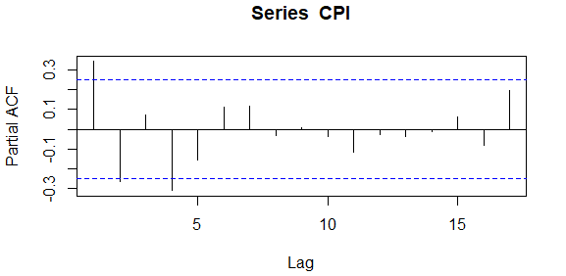
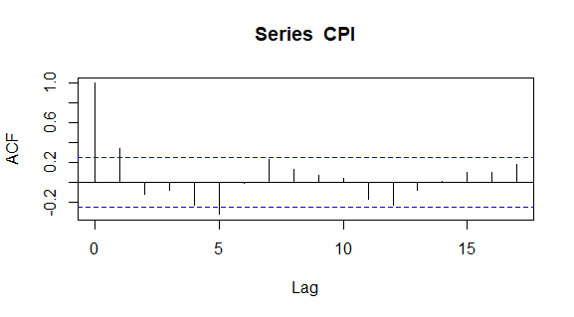
Methodology
Then we plot the Acf and Pacf graphs of CPI:-
The Pacf (p) value of CPI is significant at :- 1,2 & 4
The Acf (q) value CPI is significant at :- 1 & 5
Then we use the different combinations of p and q try to forecast the CPI.
After Training and Testing ARIMA(4,0,5) was the best fit for CPI.

Slide 9
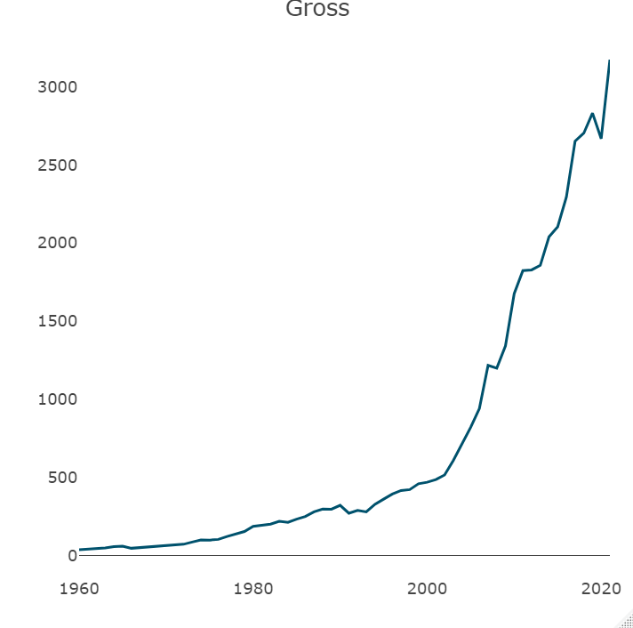
Methodology
Then we use the VAR model to forecast the GDP as dependent variable and CPI as the independent variable.
We plot the graph of GDP and CPI.

Slide 10
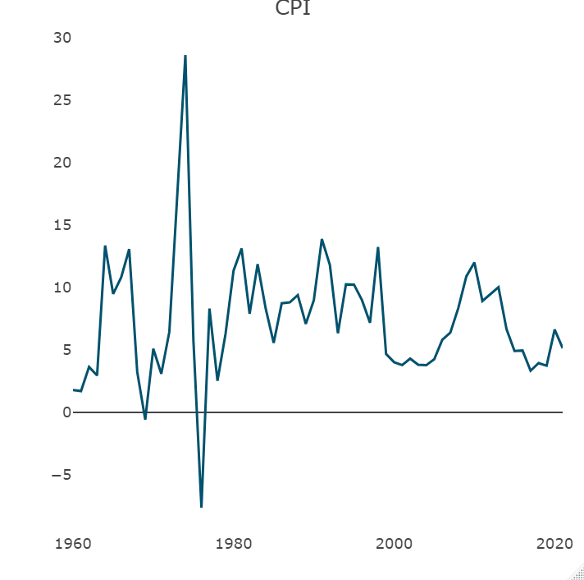
Methodology
Using the Lag select function we select the lag.
We test on initial lag max as 25 out of that the appropriate lag with minimum AIC was be 18, so the model is VAR(18).
Then we test lag max as 15 out of that the appropriate lag with minimum AIC was be 15, model is VAR(15).
Then we test lag max as 5 out of that the appropriate lag with minimum AIC was be 2, model is VAR(2).

Slide 11
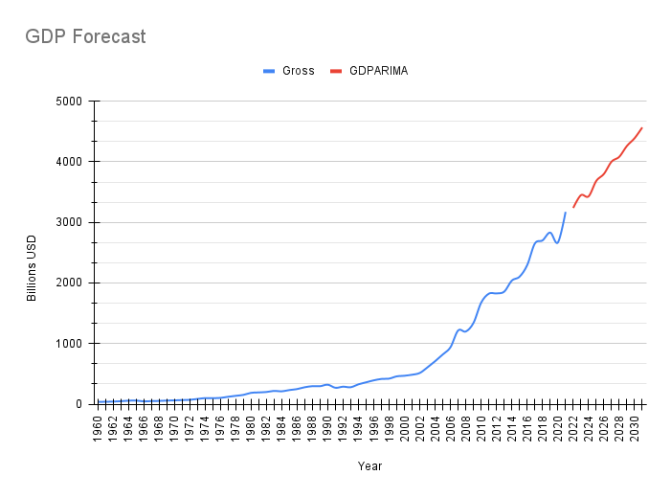
Results
Here we forecast the result of GDP and CPI using both ARIMA and VAR.
This the GDP forecast using ARIMA.

Slide 12
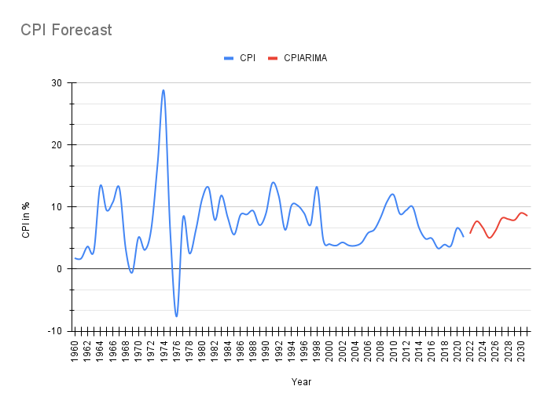
Results
This the CPI forecast using ARIMA.

Slide 13
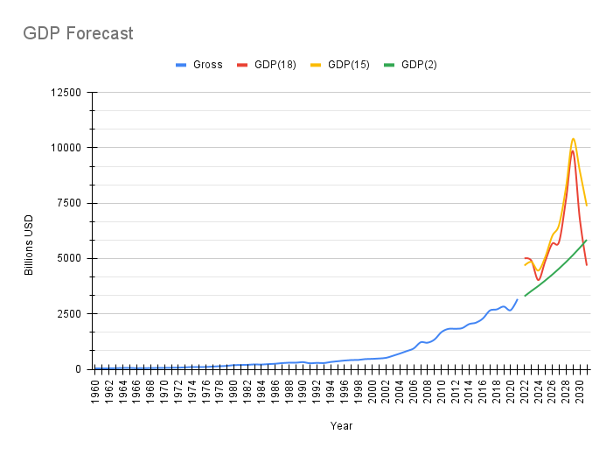
Results
This the GDP forecast using VAR.

Slide 14
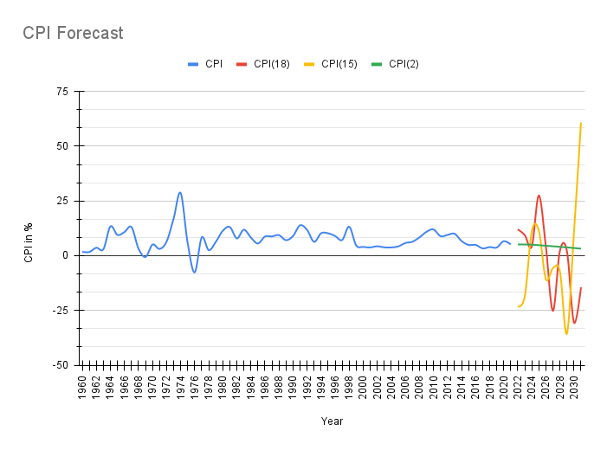
Results
This the CPI forecast using VAR.

Slide 15
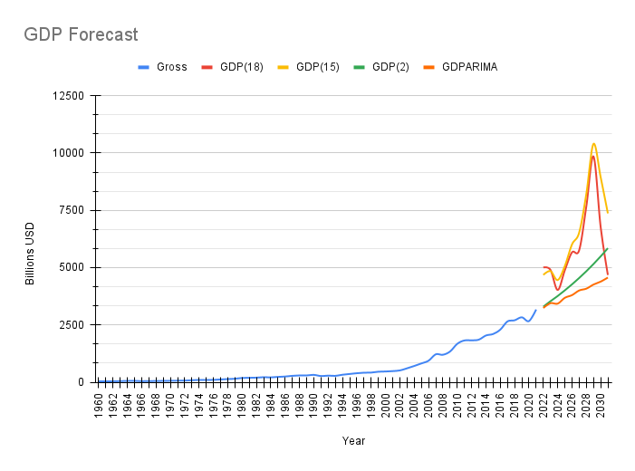
Results
Combine Graph of GDP using both ARIMA and VAR to compare each other.

Slide 16

Results
Combine Graph of CPI using both ARIMA and VAR to compare each other.

Slide 17
GARCH
The Generalized ARCH (GARCH), as developed by Bollerslev, (1986), is an extension of the ARCH model.
The conditional variance of is obtained simply by taking the conditional expectation of the squared mean corrected returns.
Equation;
r_{t}² (1)= 𝛼₀+Σ_{i=1}(𝛼_{i}+B_{j})E(r_{t+1}²+r_{t})-B_{j}Σ_{i=1}E(V_{t+1-i}|r_{t})
GARCH model implies that the positive and negative residuals have a symmetric impact on the conditional variance.
symmetric GARCH model perform better than the asymmetric GARCH but for fluctuation period (crisis period), asymmetric GARCH model is preferred.
m
p

Slide 18
GARCH model captures most of the variability in most stabilized series.
As the GARCH coefficient value is higher than the ARCH coefficient value, we can conclude that the volatility is highly persistent and clustering.
The constraint of positive coefficients is usually imposed on a Garch model to avoid negative residual variances.
We also tried to do ARCH test, but after transforming GDP to stationary, null hypothesis showed that model does not have ARCH effect. In the ARCH(q) process the conditional variance is specified as a linear function of past sample variances only, whereas the GARCH(p, q) process allows lagged conditional variances to enter as well.
Cointegration test ; johansen cointegration test , without linear trend and constant in cointegration
Phillips-Ouliaris Cointegration Test ; The value of the test statistic is: 1.7406
In general, 2 value of t stat is fine to say it is significant.

Slide 19
RESEARCH DESIGN
The research design was experimental, since the main objective of this study was to forecast the GDP level in India using the ARIMA, VAR and GARCH.
Experimental research allows the researcher to control the situation and identify the cause and effect relationships between variables and also distinguish placebo effects from treatment effects.
While studying we did not compare GDP of India with other countries.

Slide 20
References
https://www.semanticscholar.org/paper/The-Impact-of-Oil-Price-Inflation-on-Economic-of-Liaqat-Ashraf/62fa09680e758a5063bbf11b624ee6e7e03b9a36
https://www.semanticscholar.org/paper/How-Inflation-and-Interest-Rates-Are-Related-to-A-Bhunia/56d5521912d89df730b82204690130c41a98a0bd
http://koreascience.or.kr/article/JAKO202026061031263.page
http://koreascience.or.kr/article/JAKO202026061031263.page
https://opencommons.uconn.edu/cgi/viewcontent.cgi?article=1386&context=econ_wpapers
https://www.semanticscholar.org/paper/Impulse-Response-of-Inflation-to-Economic-Growth-Dinh/90afacdbc96470e413a2e3f30374cd9886aa48fe

Slide 21
THANK YOU

